Slide 1
Line of Business Solutions in SharePoint Online
Leveraging Azure and the New SharePoint Framework (SPFx)

Slide 2
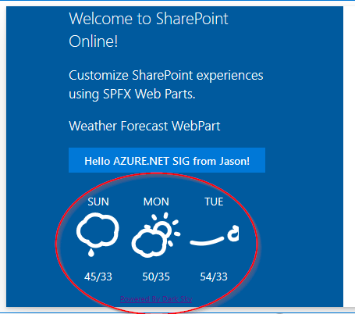
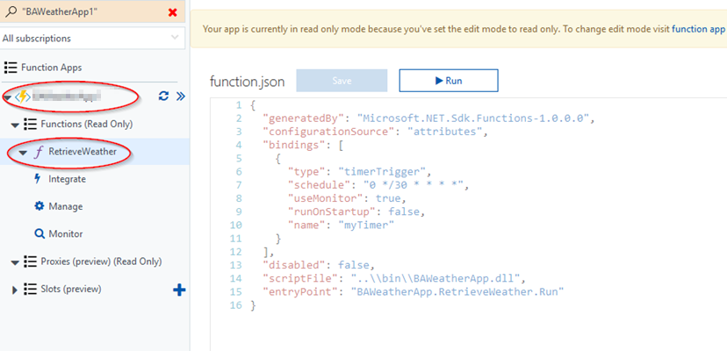
The Demonstration Solution
WEATHER WEBPART
AZURE FUNCTION (TIMER)
WEATHER LIST

Slide 3
Old Way: SharePoint Timer Job LOB Solution
User’s Browser
Darksky.net API
(Weather Forecast)
1
http request
SharePoint Page
8.1
Weather WebPart
(C#/ascx/dll)
3
Timer Service Engine
7
RetrieveWeather()
(Timer Job)
Queries List on Demand
8.2
Polls Every 30 Minutes
4
Weather List
5.2
6
5.1
Updates Every 30 min. After the Poll
2
SharePoint On-Premises

Slide 4
Why the Old Way Doesn’t Work in The Cloud
DLL (full trust solution) timer job registered on SharePoint Farm Servers -> Cannot deploy dlls on Microsoft’s SPO Servers.
WebPart solution deploys files and dlls to the SharePoint Farm Servers -> Cannot deploy anything on the Microsoft SPO Servers.
Now What?

Slide 5
New Way: Azure Timer Job LOB Solution
User’s Browser
Darksky.net API
(Weather Forecast)
https request
1
8.1
SharePoint Page
SPFx Weather WebPart
7
Polls Every 30 Minutes
4.1
Queries List on Demand
8.2
RetrieveWeather()
(Azure Function)
Weather List
6
3
Updates Every 30 After the Poll
4.2
2
Azure Tenant
5
SPO Tenant

Slide 6
Azure Functions
Serverless Compute Experience
Create Functions in C#, Javascript, F#, Python, PHP, etc.
Timer Based Processing
Triggers
https://azure.microsoft.com/en-us/services/functions/

Slide 7
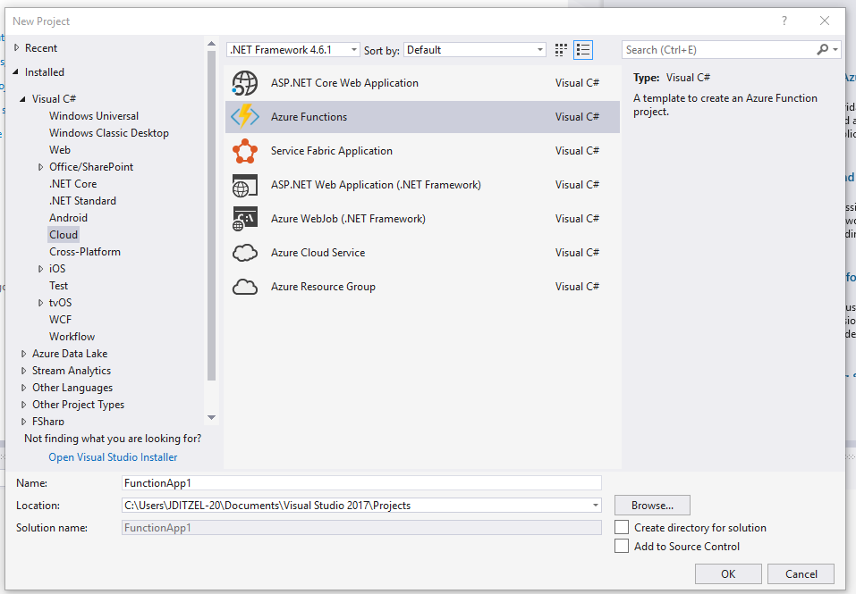
Excellent Visual Studio 2017 Integration
CREATING AN AZURE FUNCTION IN VISUAL STUDIO

Slide 8
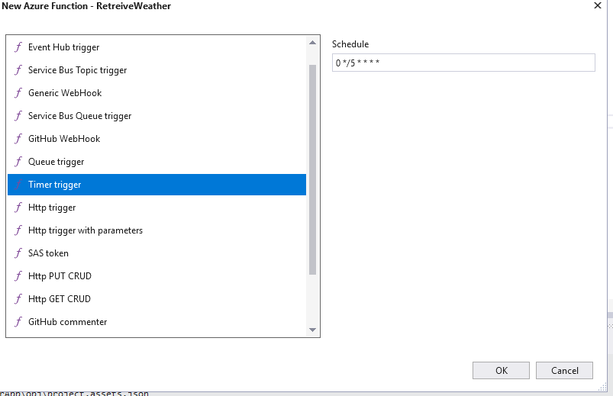
Selecting the Azure Function Type (Timer)

Slide 9
Explore the Function in C#
[Demo Function Code]

Slide 10
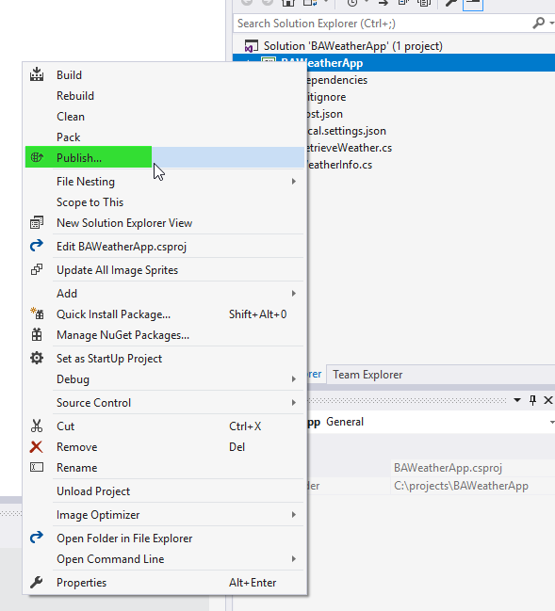
Publishing the Azure Function from VS2017

Slide 11
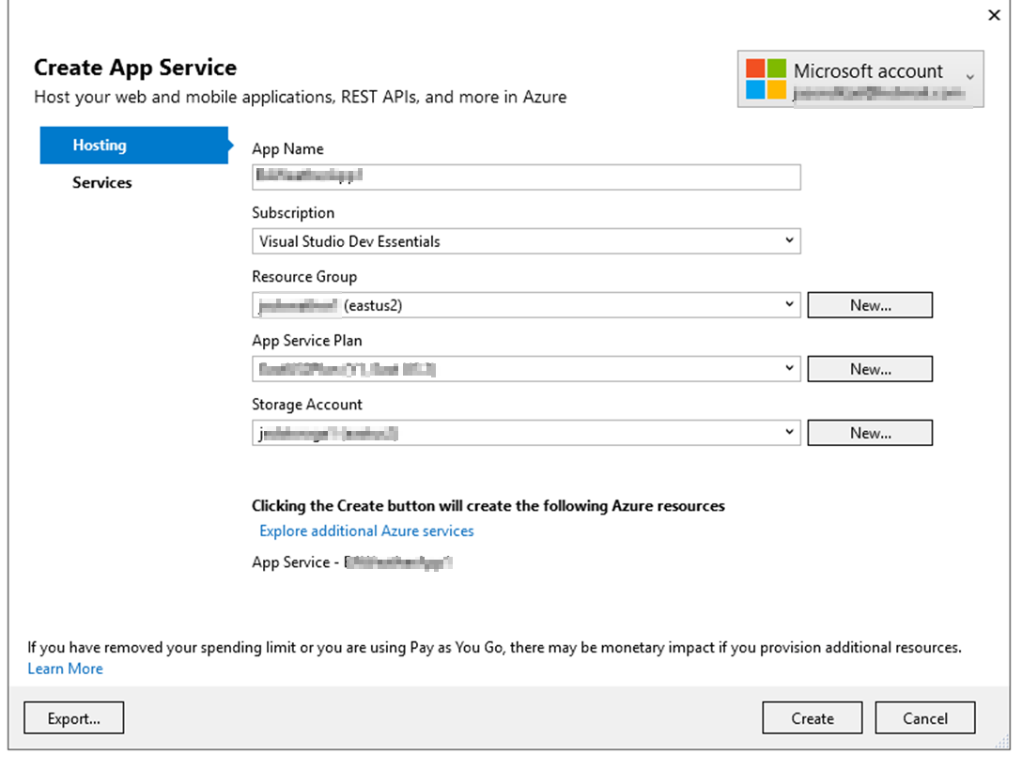
Creating the App Service to Hold the Function

Slide 12
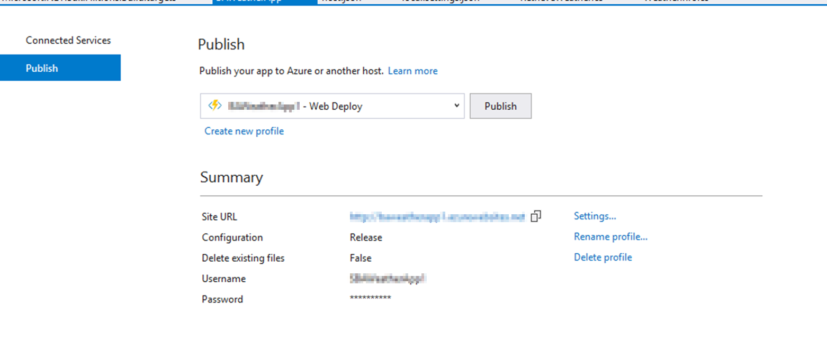
Finalize and Publish
Notes:
DEMO what it looks like in Azure

Slide 13
The SharePoint Framework (SPFx)
Provides browser support for client-side customization
Provides easy access to SharePoint data
Customizations run in current user context
Open source web dev tools
Became generally available in SPO Spring ’17
*JUST* released to On-Premises SP2016 Fall ‘17

Slide 14
SPO Development Environment
SPO App Catalog Site – necessary for production deployment
SPO Developer Site – necessary for testing
[Demo Sites]

Slide 15
SPFx Development Stack
Beware - Culture Shock for the C# Developer!
I Very Quickly Grew to Like It.
Very Fast Update->Deploy->Test Cycle Compared to Traditional SPDev

Slide 16
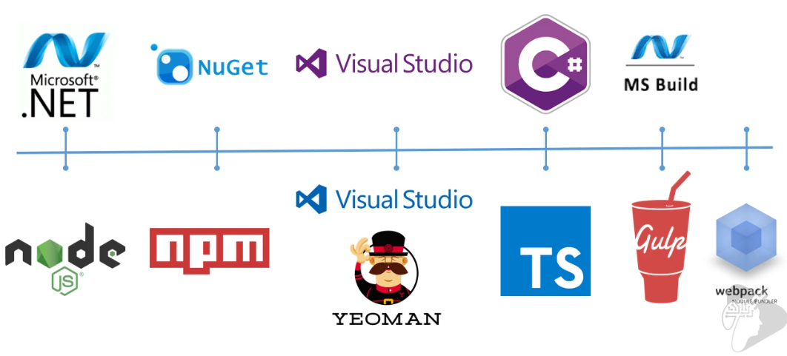
Dev Tool Comparison
Excellent Training Course-> https://www.voitanos.io/products/mastering-the-sharepoint-framework-starter

Slide 17
SPFx Local Workbench
Runs Node.js server locally
gulp serve
[Demo]

Slide 18
Visual Studio Code and Typescript
[Code Review]

Slide 19
Create a New Solution with Yeoman
[Demo]
Notes:
Mkdir helloWorldWebPart02
Yo @microsoft/sharepoint

Slide 20
SPFx SPO Workbench
Node.js server still running locally
Context finds SPO site and uses real data
[Demo]

Slide 21
Making a Code Change in Dev
[Demo of Lifecycle]

Slide 22
Deployment
Determine asset hosting location (Azure CDN – Office 365 CDN)
Javascript
Images
Web Assets
There will be a configuration process for the assets
A .sppkg file will be uploaded to SPO App Catalog and the solution made available

Slide 23
Other LOB Ideas With Timer Technique
Stock Ticker WebPart (classic)
Review Reminder on a SP Library
Trigger a MS Flow for a Workflow
Move Data from External DB into SP
Create a new site when CRM customer record added
Apply metadata to a DocSet when CRM customer record updated

Slide 24
References
https://dev.office.com/sharepoint/docs/spfx/set-up-your-developer-tenant
https://rencore.com/blog/migrate-sharepoint-javascript-customizations-to-sharepoint-framework-reference-functions-from-script-files/
https://docs.com/european-collaboration-summit/5284/building-great-client-side-web-parts-with-spfx
https://darksky.net/dev/docs
http://darkskyapp.github.io/skycons/
https://docs.microsoft.com/en-us/sharepoint/dev/sp-add-ins/working-with-lists-and-list-items-with-rest
https://www.voitanos.io/products/mastering-the-sharepoint-framework-starter

